Slide 1
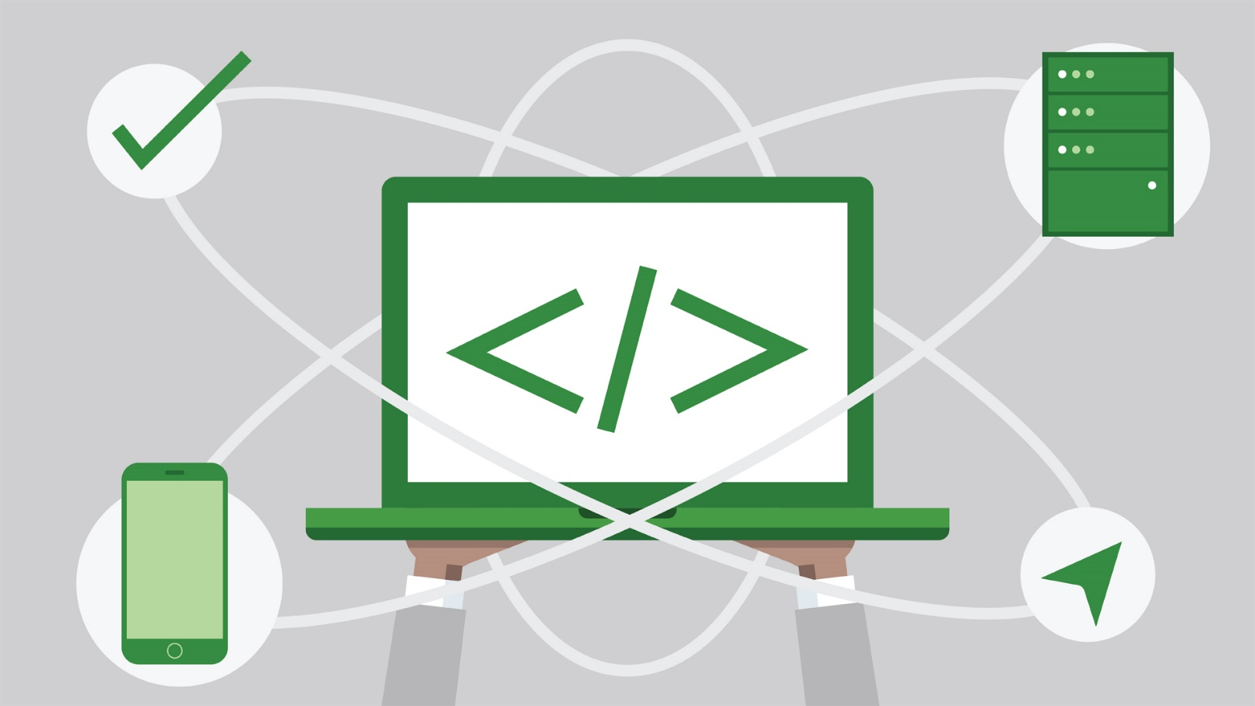
Common Web Tools for Dynamic Websites
Cashing, Cookies, Sessions, etc.
SoftUni Team
Technical Trainers
Software University
https://softuni.bg

Slide 2
Table of Contents
Django's cache framework
Django's session framework
Django's middleware framework
Django signals
Pagination

Slide 3
Have a Question?
sli.do #python-web

Slide 4

Django's Cache Framework

Slide 5
Cache
To cache something is to save the result of an expensive calculation so that you don't have to perform the calculation next time
When a cache client attempts to access data, it first checks the cache
If the page is in the cache return the cached page
Otherwise, generate the page and save the generated page in the cache (for next time) and then return the generated page

Slide 6
Django's Cache Framework
It lets you save dynamic pages, so they don't have to be calculated for each request
Django offers different levels of caching
Cache the output of specific views
Cache only the pieces that are difficult to produce
Cache the entire site
It requires a small amount of setup
Your cache preference goes in the CACHES setting

Slide 7
Memcached
Entirely memory-based cache server
Reduces database access and dramatically increases site performance
Memcached is running on localhost port 11211, using the pymemcache binding
CACHES = {
'default': {
'BACKEND':
'django.core.cache.backends.memcached.PyMemcacheCache',
'LOCATION':
'127.0.0.1:11211',
}
}

Slide 8
Redis
In-memory database that can be used for caching
You'll need a Redis server running either locally or on a remote machine
Redis is running on localhost port 6379
CACHES = {
'default': {
'BACKEND':
'django.core.cache.backends.redis.RedisCache',
'LOCATION':
'redis://127.0.0.1:6379',
}
}

Slide 9
Database Caching
Django can store its cached data in your database
Before using the database cache, you must create the cache table
The name of the table is taken from LOCATION
CACHES = {
'default': {
'BACKEND':
'django.core.cache.backends.db.DatabaseCache',
'LOCATION':
'cache_table_name',
}
}

Slide 10
Filesystem Caching
It serializes and stores each cache value as a separate file
The directory path should be absolute - it should start at the root of your filesystem
It stores cached data in /var/tmp/django_cache
CACHES = {
'default': {
'BACKEND':
'django.core.cache.backends.filebased.FileBasedCache',
'LOCATION':
'/var/tmp/django_cache',
}
}

Slide 11
Local-Memory Caching
The default cache if another is not specified in your settings file
The LOCATION is used to identify individual memory stores
CACHES = {
'default': {
'BACKEND':
'django.core.cache.backends.locmem.LocMemCache',
'LOCATION':
'some-location',
}
}

Slide 12
Caching for Development
It implements the cache interface without doing anything
It is useful for a development/test environment where you don't want to cache
CACHES = {
'default': {
'BACKEND':
'django.core.cache.backends.dummy.DummyCache',
}
}

Slide 13

Django's Session Framework
Usages and Control

Slide 14
What are Sessions?
The messages between the client and server are completely independent of each other
There is no notion of "sequence" or behavior based on previous messages
So, the sessions help you to store and retrieve arbitrary data on a per-site-visitor basis
Keep track of the "state" between the site and a particular browser
Has the data available to the site whenever the browser connects

Slide 15
Why We Need Sessions?
Provide individual users with a customized experience, based on their previous use of the site, preferences, etc.
Which account the user is logged in with
The user's browsing activity
Information previously entered into form fields
Hiding warning messages that the user has previously acknowledged
Store and respect the user's preferences, etc.

Slide 16
Session Structure
"hje85d3" : {
user_id: 789
username: FirstUser
},
"af354dd" : {
user_id: 456
username: SecondUser
},
"fg78e5s" : {
user_id: 654
username: ThirdUser
}
Unique
Session ID
Key-Value pairs with user data

Slide 17
What Are Cookies?
Cookies are used to store information
A small file of plain text with no executable code
Sent by the server to the client's browser
Stored by the browser on the client's device (computer, tablet, etc.)
Hold small piece of data for a particular client and a website
Cookies are only stored on the client-side machine
Django uses a cookie containing a special session id to identify each browser and its associated session with the site

Slide 18



Relation with Cookies
Session Store
sid 5 { uid: 101 }
sid 7 { uid: 102 }
Cookie {
name: sid value: 5
}
Validate
Req
Web Application
Session
Resp
Database
Cookie {
name: sid value: 7
}
Req
Get data
uid name 101 Teo
102 Bojo
Resp
Create personal web page

Slide 19
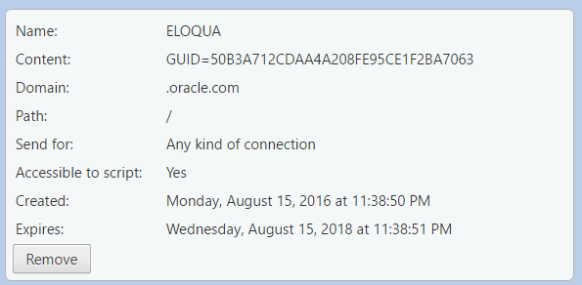
What is in the Cookie?
The cookie file contains a table with key-value pairs

Slide 20
Enabling Sessions
Sessions were enabled automatically when you create a new project
The configuration is set up in the settings.py
INSTALLED_APPS = [
...
'django.contrib.sessions',
MIDDLEWARE = [
...
'django.contrib.sessions.middleware.SessionMiddleware',

Slide 21
Using Sessions
The HttpRequest (request) object in a view have a session attribute, which is a dictionary-like object
You can read, write or edit request.session at any point in your view
def index(request):
num_visits = request.session.get('num_visits', 0)
request.session['num_visits'] = num_visits + 1
result = str(request.session['num_visits'])
return HttpResponse('Number of visits: ' + result)

Slide 22
Rules
Use strings as dictionary keys
Do not use keys that begin with an underscore
Do not override it with a new object
def post_comment(request, new_comment):
if request.session.get('has_commented', False):
return HttpResponse("You've already commented.")
c = comments.Comment(comment=new_comment)
c.save()
request.session['has_commented'] = True
return HttpResponse('Thanks for your comment!')

Slide 23

Django's Middleware Framework

Slide 24
Middleware Framework
Middleware is a framework of hooks into Django's request/response processing
It means that they are processed upon every request/response the Django handles
Each middleware component is responsible for doing some specific function
You could use the built-in middleware components or write your own

Slide 25
Middleware Class
A Middleware is a regular Python class
The Middleware classes doesn't have to subclass anything
The path to the class should be registered in the MIDDLEWARE at the project settings.py
MIDDLEWARE = [
# write the path here
]

Slide 26
Ordering Middleware
The Middleware classes are called twice during the request/response life cycle
During the request cycle, the Middleware classes are executed top-down
During the response cycle, the Middleware classes are executed bottom-up

Slide 27
Cache Middleware Classes
Once the cache is set up (as in the first section), the simplest way to use caching is to cache your entire site
The "update" middleware must be first in the list, and the "fetch" middleware must be last
Automatically sets a few headers in each HttpResponse
MIDDLEWARE = [
'django.middleware.cache.UpdateCacheMiddleware',
'django.middleware.common.CommonMiddleware',
'django.middleware.cache.FetchFromCacheMiddleware',
]
Caches GET and HEAD responses with status 200

Slide 28
Security Middleware Classes
The "security" Middleware provides several security enhancements to the request/response cycle
Each one can be independently enabled or disabled with a setting
MIDDLEWARE = [
'django.middleware.security.SecurityMiddleware',
...
]
All built-in Middleware classes: https://docs.djangoproject.com/en/4.0/ref/middleware/

Slide 29
Custom Middleware
First, create a middleware factory that takes a get_response callable and returns a middleware
The get_response callable
Can be the next middleware in the chain
Can be the actual view, if this is the last listed middleware
Then, create a middleware that takes a request and returns a response, just like a view

Slide 30
Custom Middleware Structure
def simple_middleware(get_response):
# One-time configuration and initialization
def middleware(request):
# Code to be executed for each request before
# the view (and later middleware) are called
response = get_response(request)
# Code to be executed for each request/response after
# the view is called
return response
return middleware

Slide 31

Django Signals

Slide 32
What are Signals?
The Django Signals is a strategy to allow decoupled applications to get notified when certain events occur
A common use case is when you extend the Custom Django User by using the Profile strategy through a one-to-one relationship
We use a "signal dispatcher" to listen for the User's post_save event to also update the Profile instance as well

Slide 33
When to Use Signals
When many pieces of code may be interested in the same events
When you need to interact with a decoupled application, e.g.
A Django core model
A model defined by a third-party app

Slide 34
pre_save/post_save
Use when the business requirement of an application may require some processing just before or after saving the data to the database
One possible way is to override the save() method on each model
More efficient way is to use Django signals
These components work on the concept of senders (usually the model) and receivers (usually the processing function)

Slide 35
Simple Example (1)
Just before an order is saved, the inventory should be checked to ensure the item is in stock
from django.db.models.signals import pre_save
def validate_order(sender, instance, **kwargs):
if instance.quantity < instance.inventory_item.quantity:
# order can be fulfilled
instance.save()
else:
# write logic to reject save and give message why
pre_save.connect(validate_order, sender=Order)

Slide 36
Simple Example (2)
After an order is saved, there should be a logic to send a notification that the order has been received
from django.db.models.signals import post_save
from myapp.utils import send_notification
def notify_user(sender, instance, **kwargs):
send_notification(instance.ordered_by)
post_save.connect(notify_user, sender=Order)
All Django signals: https://docs.djangoproject.com/en/4.0/topics/signals/

Slide 37

Pagination

Slide 38
Pagination
Pagination is used to divide returned data and display it on multiple pages within one web page
Pagination includes the logic of preparing and displaying the links to the various pages
Paginated data is data that's split across several pages, with "Previous"/"Next" links
Django provides high-level and low-level ways to help you manage it

Slide 39
The Paginator Class
All methods of pagination use the Paginator class
It does all the heavy lifting of splitting a QuerySet into Page objects
from django.core.paginator import Paginator
def listing(request):
employees_list = Employee.objects.all()
paginator = Paginator(employees_list, 25)
page_number = request.GET.get('page')
page_obj = paginator.get_page(page_number)
return render(request, 'list.html', {'page_obj': page_obj})

Slide 40
Pagination in CBV
The ListView provides a built-in way to paginate the displayed list
It limits the number of objects per page and adds a paginator and page_obj to the context
from django.views.generic import ListView
from myapp.models import Contact
class EmployeeListView(ListView):
paginate_by = 2
model = Employee

Slide 41
Pagination in the Template
{% for employee in page_obj %}
{{ employee.full_name }}<br>
{% endfor %}
{% if page_obj.has_previous %}
<a href="?page=1">first</a>
<a href="?page={{ page_obj.previous_page_number }}">previous</a>
{% endif %}
Page {{ page_obj.number }} of {{ page_obj.paginator.num_pages }}.
{% if page_obj.has_next %}
<a href="?page={{ page_obj.next_page_number }}">next</a>
<a href="?page={{ page_obj.paginator.num_pages }}">last</a>
{% endif %}

Slide 42

Live Exercises in Class
Practicing

Slide 43

Summary
Django's cache framework
Django's session framework
Django's middleware framework
Django signals
Pagination
…
…
…

Slide 44
Questions?
Notes:
44

Slide 45













SoftUni Diamond Partners

Slide 46


Educational Partners

Slide 47
Trainings @ Software University (SoftUni)
Software University – High-Quality Education, Profession and Job for Software Developers
softuni.bg, about.softuni.bg
Software University Foundation
softuni.foundation
Software University @ Facebook
facebook.com/SoftwareUniversity
Software University Forums
forum.softuni.bg
Notes:
47

Slide 48

License
This course (slides, examples, demos, exercises, homework, documents, videos and other assets) is copyrighted content
Unauthorized copy, reproduction or use is illegal
© SoftUni – https://about.softuni.bg/
© Software University – https://softuni.bg
Notes:
48

